Slide 1
Click on links below to read ISD 196’s Local Literacy Plan
Statement of Literacy Goal
Student Assessment Process
Parent Notification
and Involvement
Intervention
and Instructional Supports
Curriculum
and Instruction System
Student Support System
for English Language Learners
Annual Report
Professional Development on Literacy Instruction
Educating our students to meet their full potential

Slide 2
Literacy Goal
It is the goal of District 196 to ensure every child is reading at or above grade level by the end of third grade and beyond in order to achieve college and career readiness.
It is the goal of District 196 to ensure every child is reading at or above grade level by the end of third grade.
District Insurance of Proficiency Plan
District Insurance of Proficiency Plan

Slide 3
Insurance of Proficiency Plan
Balanced Literacy Core Instruction
Assessments
The 2010 Minnesota K-12 Academic Standards in English Language Arts
Literacy Continuum by Fountas & Pinnell and The Literacy Collaborative®
Observation Survey by Marie Clay
Words Their Way Spelling Inventory by Donald Bear
Benchmark Assessment System (BAS) by Fountas & Pinnell
Definition of Proficiency

Slide 4
Definition of Proficiency
Kindergarten
First Grade
Second Grade
Third Grade

Slide 5
Definition of Proficiency
Kindergarten
By the end of kindergarten, to show proficiency, students should be at:
Level B on the BAS
47/54 points on Letter Identification
23/37 points on the Sentence Dictation (Hearing and Recording Sounds in Words)
15/24 points on Concepts About Print
Demonstrate the ability to write 23 words correctly in a ten minute time frame.

Slide 6
Definition of Proficiency
First Grade
By the end of first grade, to show proficiency, students should be at:
Level I on the BAS
33/37 points on the Sentence Dictation (Hearing and Recording Sounds in Words)
18 points on Concepts About Print
Demonstrate the ability to write 51 words correctly in a ten minute time frame.

Slide 7
Definition of Proficiency
Second Grade
By the end of second grade, to show proficiency, students need to show an Independent Level L on the BAS based on the comprehension chart below.
While other assessments are used to gather feedback on a child’s literacy growth including classroom assessments, and the Measures of Academic Progress (MAP), this one-on-one assessment gives our instructors standardized and comprehensive information regarding students’ performance in reading.

Slide 8
Definition of Proficiency
Third Grade
By the end of third grade, to show proficiency, students need to show an Independent Level O on the BAS based on the comprehension chart below.
While other assessments are used to gather feedback on a child’s literacy growth including classroom assessments, and the Measures of Academic Progress (MAP), this one-on-one assessment gives our instructors standardized and comprehensive information regarding students’ performance in reading.

Slide 9
Student Assessment Process
Summer Assessments
Year Round Assessment Plan
District 196 has instituted a systemic change to allow all students to have a full 45 minute individualized screening in the fall. This will allow differentiated instruction and interventions to begin the first week of school.
District 196 is committed to differentiated instruction, systematic intervention and monitoring based on data . Teacher teams will meet every six weeks to examine and plan instruction using student data.

Slide 10
Summer Assessment Plan
Individualized Summer Screening
Fall Parent Teacher Conferences
Each child will have the opportunity to meet their teacher and have a forty-five minute one on one screening.
Testing will allow teachers to know your child as an individual from the first day of school.
Teachers will be able to differentiate instruction and meet the needs of students with interventions that match individual needs by testing before school.
Click the link below for a more detailed
Grade by Grade Assessment Plan
Parents will have the opportunity to meet with their child’s teacher during fall conferences to hear about their child’s fall testing.
Testing will allow teachers to know your child as an individual from the first day of school.
Teachers will be able to differentiate instruction and meet the needs of students with interventions that match individual needs by testing before school.
Click the link below for a more detailed
Parent Notification and Involvement Plan

Slide 11
Year Round Assessment Plan
Assessment Data Collection 2012-13
Before School Data Collection Due: Friday, September 7, 2012
November Kindergarten Data Collection Due: November 21, 2012 January Data Collection Due: January 18, 2013
March Data Collection Due: March 1, 2013
Spring Data Collection Due: May 31, 2013
For more information on grade by grade assessment plan, click here.

Slide 12
Grade by Grade Assessment Plan
Kindergarten
First Grade
Second Grade
Third Grade

Slide 13
Kindergarten Assessment Plan
Concepts About Print to determine what the child knows about the way spoken language is represented in print.
Letter Identification to determine which letters the child knows.
Writing Vocabulary to determine if the child is building a personal resource of known words that can be written in every detail.
Hearing and Recording Sounds to assess phonemic awareness by determining how the child represents sounds in graphic form.
Text Leveling to determine an appropriate level of text difficulty and to record what the child does when reading continuous text (using a reading record).
Diminishing Testing Model
Click here
For more information on grade by grade assessment plan, click here.
Detailed Information about the Observation Survey

Slide 14
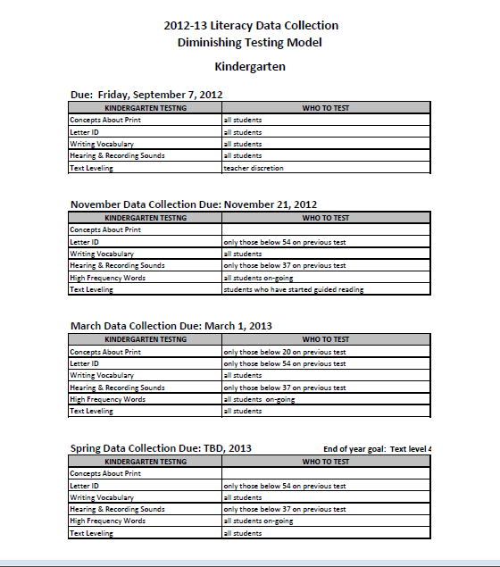
Kindergarten Diminishing Testing Model

Slide 15
First Grade Assessment Plan
Text Leveling to determine an appropriate level of text difficulty and to record what the child does when reading continuous text (using a reading record).
Writing Vocabulary to determine if the child is building a personal resource of known words that can be written in every detail.
Spelling Inventory to determine word knowledge and stages of spelling development.
If below text level 14/H
Hearing and Recording Sounds to assess phonemic awareness by determining how the child represents sounds in graphic form.
Letter Identification to determine which letters the child knows.
Concepts About Print to determine what the child knows about the way spoken language is represented in print.
Diminishing Testing Model
Click here
For more information on grade by grade assessment plan, click here.
Detailed Information about the Observation Survey

Slide 16
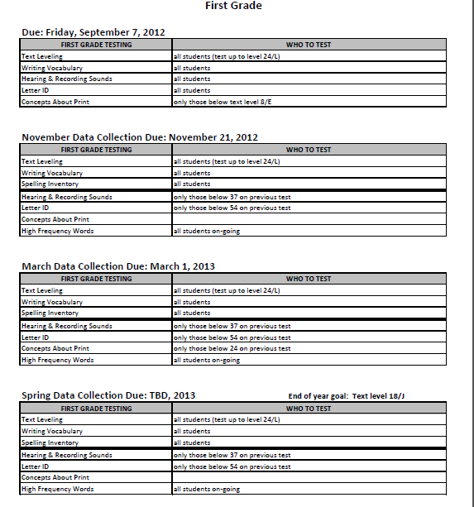
First Grade Diminishing Testing Model

Slide 17
Second Grade Assessment Plan
Text Leveling to determine an appropriate level of text difficulty and to record what the child does when reading continuous text (using a reading record).
High Frequency Words to determine knowledge of the most common words in English, ranked in frequency order.
Spelling Inventory to determine word knowledge and stages of spelling development.
If below text level 14/H
Letter Identification to determine which letters the child knows.
Concepts About Print to determine what the child knows about the way spoken language is represented in print.
Writing Vocabulary to determine if the child is building a personal resource of known words that can be written in every detail.
Hearing & Recording Sounds to assess phonemic awareness by determining how the child represents sounds in graphic form.
Diminishing Testing Model
Click here
For more information on grade by grade assessment plan, click here.

Slide 18
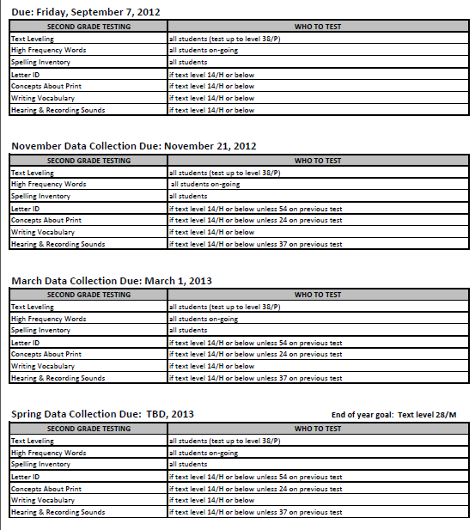
Second Grade Diminishing Testing Model

Slide 19
Third Grade Assessment Plan
Text Leveling to determine an appropriate level of text difficulty and to record what the child does when reading continuous text (using a reading record).
High Frequency Words to determine knowledge of the most common words in English, ranked in frequency order.
Spelling Inventory to determine word knowledge and stages of spelling development.
If below text level 14/H
Letter Identification to determine which letters the child knows.
Concepts About Print to determine what the child knows about the way spoken language is represented in print.
Writing Vocabulary to determine if the child is building a personal resource of known words that can be written in every detail.
Hearing & Recording Sounds to assess phonemic awareness by determining how the child represents sounds in graphic form.
Diminishing Testing Model
Click here
For more information on grade by grade assessment plan, click here.

Slide 20
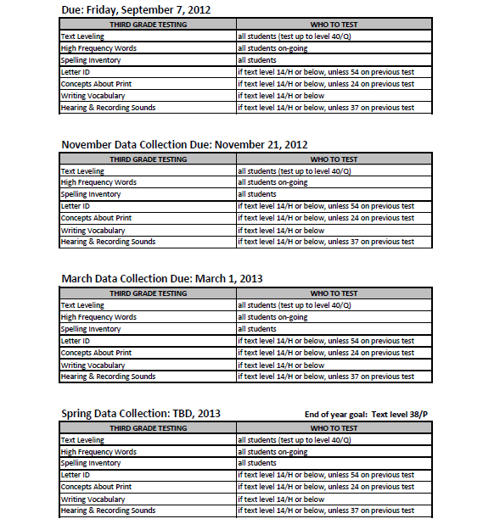
Third Grade Diminishing Testing Model

Slide 21
Parent Notification and Involvement
Kindergarten Notification Letter
First Grade Notification Letter
Second Grade Notification Letter
Third Grade Notification Letter

Slide 22
Kindergarten Parent Notification and Involvement
Developing a strong foundation in literacy is a pillar of ISD 196’s mission for each child. In kindergarten, students continue to build their strong literacy skills by applying them all in reading and comprehending text. To determine proficiency, the Benchmark Assessment System (BAS) is administered one-on-one with each student. Additionally, students are assessed in the areas of letter identification (upper and lower case letters), hearing sounds in words, and writing vocabulary.
By the end of kindergarten, to show proficiency, students should be at:
Level B on the BAS
47/54 points on Letter Identification
23/37 points on the Sentence Dictation (Hearing and Recording Sounds in Words)
15/24 points on Concepts About Print
Demonstrate the ability to write 23 words correctly in a ten minute time frame.
Students who have not met one or more of these grade level benchmarks in reading will continue to be provided targeted intervention in reading through guided reading and guided writing groups, as well as specific instruction in the literacy areas of need.
This summer, continue to support your child’s growth in literacy by doing the following:
Read, sing and say rhymes.
Encourage your child to read environmental print (print of everyday life, i.e. McDonald’s® sign, brand name food labels such as Cheerios®, road signs such as the stop sign, and print in our community including billboards, calendars, and menus.)
Find a comfortable place to read and establish a pattern of reading frequently.
Reread favorite books.
Read aloud to your child daily.
Encourage writing every day, and make your own books!
Build your child’s background knowledge by talking about all that you see and hear and by taking your child to the museum or the zoo.
Model a literate life. Be a reader and a writer yourself!
We look forward to continuing this literacy growth journey with your child.
For more information on how you can help your child, please visit the District 196 website:

Slide 23
First Grade Parent Notification and Involvement
Developing a strong foundation in literacy is a pillar of ISD 196’s mission for each child. In first grade, students continue to build their strong literacy skills by applying them all in reading and comprehending text. To determine proficiency, the Benchmark Assessment System (BAS) is administered one-on-one with each student. Additionally, students are assessed in the areas of hearing sounds in words, and writing vocabulary.
By the end of first grade, to show proficiency, students should be at:
Level I on the BAS
33/37 points on the Sentence Dictation (Hearing and Recording Sounds in Words)
18 points on Concepts About Print
Demonstrate the ability to write 51 words correctly in a ten minute time frame.
Students who have not met one or more of these grade level benchmarks in reading will continue to be provided targeted intervention in reading through guided reading and guided writing groups, as well as specific instruction in the literacy areas of need.
This summer, continue to support your child’s growth in literacy by doing the following:
Find a comfortable place to read and establish a pattern of reading frequently.
Reread favorite books.
Vary who reads
Parent reads to child
Child reads to parent
Each read a book a night
From one book, read every other page
Read many different kinds of books and pick books that are at an appropriate reading level. Keep the book choice easier and enjoyable, not frustrating.
Introduce a new book to assure successful reading.
Sit with them and support them in a positive way.
Build your child’s background knowledge by talking about all that you see and hear and by taking your child to the museum or the zoo.
Encourage writing every day, and make your own books!
Model a literate life. Be a reader and a writer yourself!
We look forward to continuing this literacy growth journey with your child.
For more information on how you can help your child, please visit the District 196 website:

Slide 24
Second Grade Parent Notification and Involvement
Developing a strong foundation in literacy is a pillar of ISD 196’s mission for each child. In second grade, students continue to build their strong literacy skills by applying them all in reading and comprehending text. To determine proficiency, the Benchmark Assessment System (BAS) is administered one-on-one with each student.
By the end of second grade, to show proficiency, students need to show an Independent Level L on the BAS. While other assessments are used to gather feedback on a child’s literacy growth including classroom assessments, and the Measures of Academic Progress (MAP), this one-on-one assessment gives our instructors standardized and comprehensive information regarding students’ performance in reading.
Students who have not met the grade level benchmark in reading will continue to be provided targeted intervention in reading through
guided reading and guided writing groups, as well as specific instruction in the literacy areas of need.
This summer, continue to support your child’s growth in literacy by doing the following:
Help your child find easy books to read and reread daily.
Read to and with your child, and reread favorites again and again.
Read all sorts of print -- newspapers, magazines, books, comics, songs (the list goes on and on...).
Keep books everywhere and take them with you wherever you go.
Talk to your children about the books they are reading.
Start a neighborhood book club.
Monitor, guide and limit television and video games.
Visit your local library.
Encourage writing every day, and make your own books!
Subscribe to a magazine.
Build your child’s background knowledge by talking about all that you see and hear and by taking your child to the museum or the zoo.
Model a literate life. Be a reader and a writer yourself!
We look forward to continuing this literacy growth journey with your child.
For more information on how you can help your child, please visit the District 196 website:

Slide 25
Third Grade Parent Notification and Involvement
Developing a strong foundation in literacy is a pillar of ISD 196’s mission for each child. In third grade, students continue to build their strong literacy skills by applying them all in reading and comprehending text. To determine proficiency, the Benchmark Assessment System (BAS) is administered one-on-one with each student.
By the end of third grade, to show proficiency, students need to show an Independent Level O on the BAS. While other assessments are used to gather feedback on a child’s literacy growth including classroom assessments, the Measures of Academic Progress (MAP), and the Minnesota Comprehensive Assessment (MCA) in reading, this one-on-one assessment gives our instructors standardized and comprehensive information regarding students’ performance in reading
Students who have not met the grade level benchmark in reading, will continue to be provided targeted intervention in reading through guided reading and guided writing groups as well as specific instruction in the literacy areas of need.
This summer, continue to support your child’s growth in literacy, by doing the following:
Help your child find easy books to read and reread daily.
Read to and with your child, and reread favorites again and again.
Read all sorts of print -- newspapers, magazines, books, comics, songs (the list goes on and on...).
Keep books everywhere and take them with you wherever you go.
Talk to your children about the books they are reading.
Start a neighborhood book club.
Monitor, guide and limit television and video games.
Visit your local library.
Encourage writing every day, and make your own books!
Subscribe to a magazine.
Build your child’s background knowledge by talking about all that you see and hear and by taking your child to the museum or the zoo.
Model a literate life. Be a reader and a writer yourself!
We look forward to continuing this literacy growth journey with your child.
For more information on how you can help your child, please visit the District 196 website:

Slide 26
Intervention and Instructional Supports
Essential Questions of Education
ISD 196 Response
What do we expect students to learn?
How will we know they are learning it?
How will we respond when they don’t learn?
How will we respond when they have learned?
Focus on Learning: A crystal clear focus on what we expect students to know and be able to do.
Collaboration: Working together in teams with a commitment to strengthen our core instruction and provide additional time and targeted instruction for students who need intervention and enrichment.
Results Oriented: Evaluating our success based on results, not intentions. Using assessments to inform our instruction and answer the question: “Are students learning?”
Click here for more on intervention and instructional supports.
Adapted from R. Dufour (2004) and A. Buffum (2011)

Slide 27
Intervention and Instructional Supports
Interventions are all based on diagnostic data
Tier I—Quality, world class core literacy instruction for ALL students with specific literacy needs being targeted in the classroom during guided reading and guided writing. Additional targeted instruction can occur during individual reading and writing conferences.
Tier II—Additional time and instruction in addition to core literacy instruction provided to target individual literacy gaps.
Tier III—Additional short bursts of intervention offered by a trained individual for a very specific literacy need.
Action Research Coaching and Data Driven Professional Development
Tier 3
Tier 2
Tier 1

Slide 28
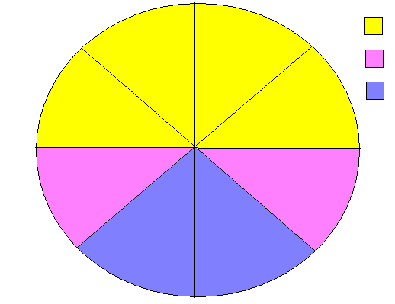
Tier 1 Interventions
Whole Group
Shared
Writing
Interactive
Read Aloud
Small Group/ individual
Application/ Assessment
Interactive Writing
Shared Reading
Data differentiates instruction to meet the needs of all learners
Writer’s Workshop
Guided Reading
Mini-lesson
Small Group Instruction
Guided Reading
Guided Writing
One on One Instruction
Writing Conference
Reading Conference
Independent Writing
Independent Reading

Slide 29
Tier 2 Interventions
Comprehensive interventions:
Language, reading, writing, word study, focus, independence
Aligned with core literacy instruction
Integrating behavioral interventions
Reading Recovery® – One-on-one instruction– First Grade
Leveled Literacy Intervention® K-3rd grade – Small Group
Leveled Literacy Intervention 4th-8th grade – Small Group

Slide 30
Tier 3 Interventions
A little bit more
Focused on an area highlighted by data
Quick and consistent, with the expectation of closing the gap

Slide 31
Professional Development Literacy Instruction

Slide 32
Curriculum and Instruction System
District 196 is following the Literacy Collaborative® researched-based model. The model aligns all instruction, intervention, and support
Tier I: Literacy Collaborative®
Tier II: Reading Recovery and Leveled Literacy Intervention Research Based Interventions with Integrated Reading, Writing, and Word Study

Slide 33
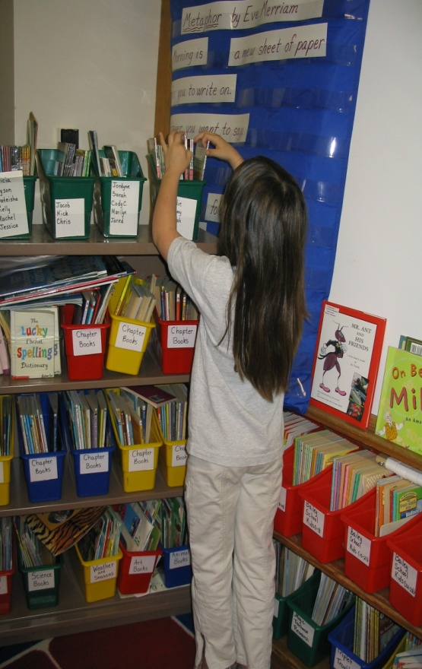
Tier 1: Research Based Whole Classroom Instruction Literacy Collaborative®
Literacy Based Model
Long Term Staff Development and Coaching Model
Data Driven Teaching and Coaching

Slide 34
Student Support System for English Learners
Program Description
The EL Program in District 196 supports learners in acquiring the English they need in order to succeed in the classroom and beyond, in accordance with the State of Minnesota Guidelines and English Language Proficiency Standards. Teachers who are fully certified in teaching English as a Second a Language work with EL students at all elementary, middle and high schools in the district. New students are tested for English proficiency when entering District 196 schools, as well as periodically throughout the school year to determine progress and eligibility for continued instruction.
EL Identification
Identification, Entrance, and Exit Procedure
Proficiency Levels

Slide 35
ISD 196 Reading Well by Grade Three Annual Report
The annual report will be created and updated here after submission of ISD 196 data to the Minnesota Department of Education on July 1, 2013.

Slide 36
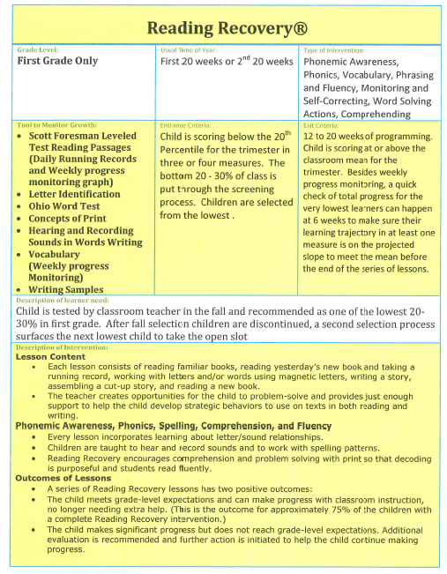
Reading Recovery®

Slide 37
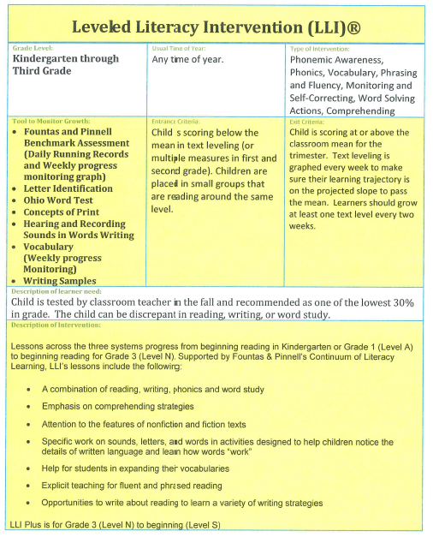
Leveled Literacy Intervention®

